Slide 1
Hidden Markov Model
Il-Chul Moon
Dept. of Industrial and Systems Engineering
KAIST
icmoon@kaist.ac.kr

Slide 2
Weekly Objectives
Learn hidden Markov model
  Transition from the static clustering to the dynamic clustering
  Understand the difference of the graphical model
Know and able to answer the three major questions of HMM
  Know how to solve the evaluation question
  Know how to solve the decoding question
  Know how to solve the learning question
Link to the previous lectures
  Link the forward-backward algorithm to the message passing
  Link the baum-welch algorithm to the EM algorithm

Slide 3
Hidden Markov Model

Slide 4





Time Series Data for GMM
$$π$$
z
Imagine the following case
  Data points on the plane
  Have a temporal trace of data points
  Now, any broken assumption in the analysis?
Any real world applications
  Many, many, many…
  Stock market analysis, text mining…
$$μ$$
$$Σ$$
x
N
KOSPI
Related…
DJIA
Related…

Slide 5





What to Model and How to Model
$$π$$
z
Previously, all data points are independent trials
  Now, they are not any further
Temporal relation: causality from time t to time t+1
Overall trend: latent state variables
$$μ$$
$$Σ$$
x
N
$$π$$
Initial State Prob
Latent Variables
z1
z2
z3
$$π$$
z1
z2
z3
x1
x2
x3
x1
x2
x3
Temporal Causality

Slide 6

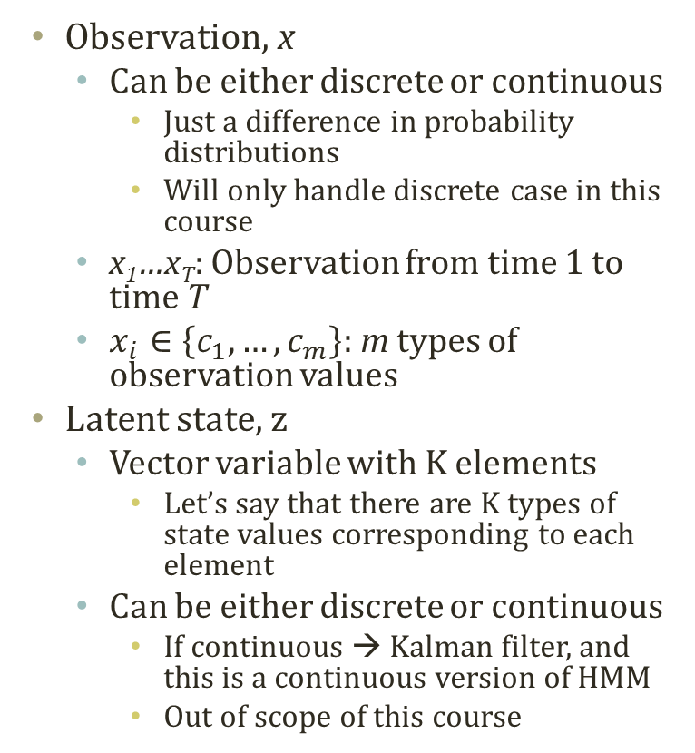
Hidden Markov Model
Observation, x
  Can be either discrete or continuous
    Just a difference in probability distributions
    Will only handle discrete case in this course
  x₁…x_{T}: Observation from time 1 to time T
  $x_{i}∈\left\{c_{1},…,c_{m}\right\}$: m types of observation values
Latent state, z
  Vector variable with K elements
    Let’s say that there are K types of state values corresponding to each element
  Can be either discrete or continuous
    If continuous → Kalman filter, and this is a continuous version of HMM
    Out of scope of this course
$$π$$
z1
z2
z3
x1
x2
x3
2
2
1
A
B
1
2
C
D
2
1
1

Slide 7
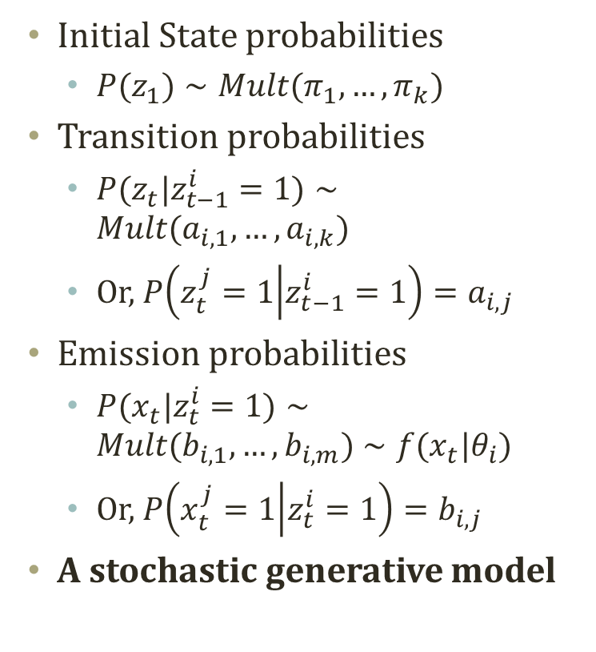
Hidden Markov Model
Initial State probabilities
  $P(z_{1})∼Mult(π_{1},…,π_{k})$
Transition probabilities
  $P(z_{t}|z_{t−1}^{i}=1)∼Mult(a_{i,1},…,a_{i,k})$
  Or, $P\left(z_{t}^{j}=1 | z_{t−1}^{i}=1\right)=a_{i,j}$
Emission probabilities
  $P(x_{t}|z_{t}^{i}=1)∼Mult(b_{i,1},…,b_{i,m})∼f(x_{t}|θ_{i})$
  Or, $P\left(x_{t}^{j}=1 | z_{t}^{i}=1\right)=b_{i,j}$
A stochastic generative model
$$π$$
z1
z2
z3
x1
x2
x3
2
2
1
A
B
1
2
C
D
2
1
1

